Slide 1
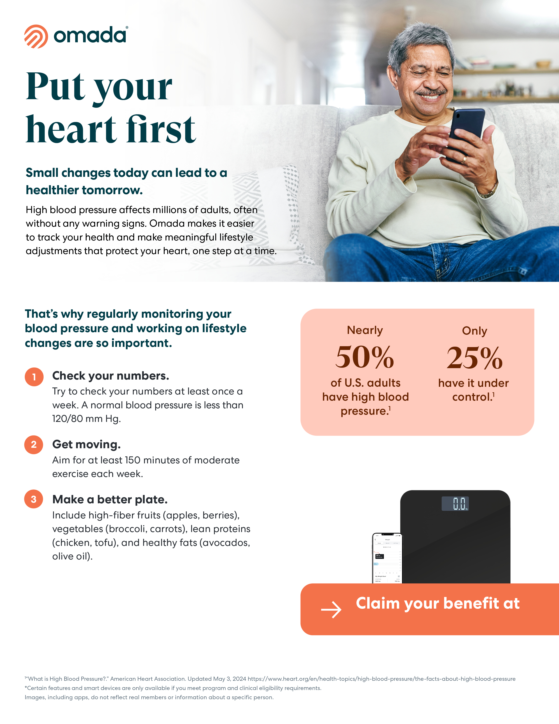
HCSC is offering Omada, a no-cost-to-you virtual health program that helps members lower blood pressure and lose weight to achieve long-lasting health changes.
omadahealth.com/healthycounty

